Slide 1
Section 3.10 Linear Approximations and Differentials

Slide 2
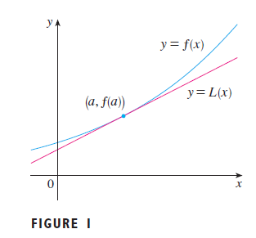
In this section we are going to see another useful application of derivatives and tangent lines.
In engineering and physics, we usually approximate a complicate function by a simple linear function when exact answers are not needed (because we won’t see a difference if the error is so small).
The advantage of using linear approximations is that the computation is much easier and hence faster, even if supercomputers is used. We need fast computations many applications such as computer animation in video games.
Look at the picture on the right, we can see that the tangent line (magenta line) is a good approximation to the blue curve near the point of contact.
And therefore if we are working in a small neighborhood of the contact point (a, f(a)), we may use the linear function y = L(x) instead of the complicated y = f(x) when the error is acceptable.

Slide 3
Example
In pure physics, when we calculate the path of light rays through a lens, we have to use the sine function.
However, in optional engineering, when design a telescope or telephoto lens, we know that the angle of view (angle α in the diagram) is very small, sometimes less than 1 degree, so that sin(α) ≈ α, and the resolution of our eyes (or photo sensors) will not see the difference if you replace sin(α) by α.
Once you replace sin(α) by α, the formula, and calculation will be much easier!

Slide 5
We change the symbol f(x) to L(x) just to mean Linear.

Slide 6
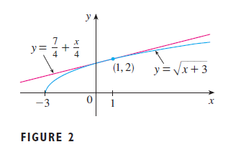

Slide 7
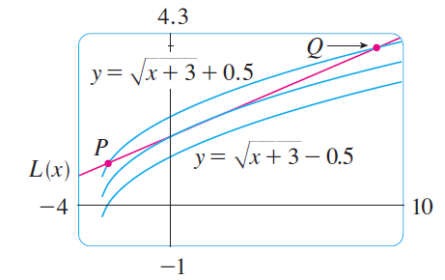

Slide 8
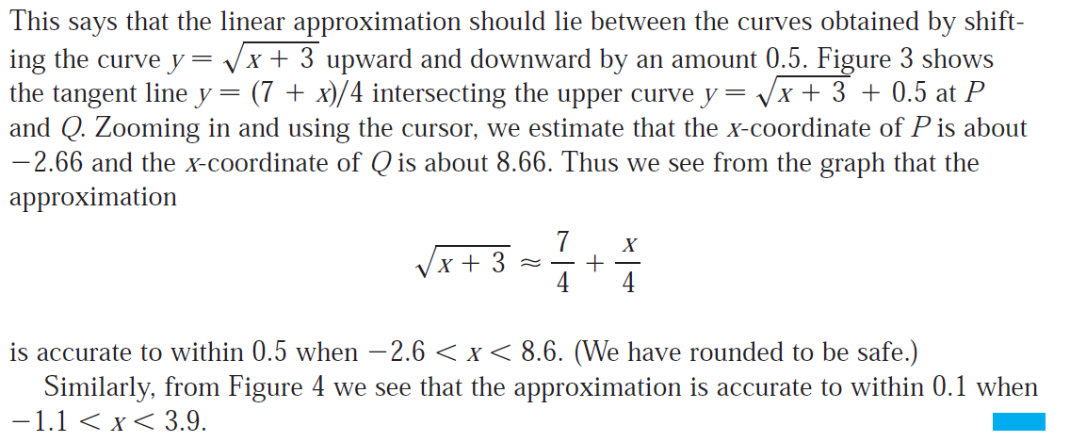
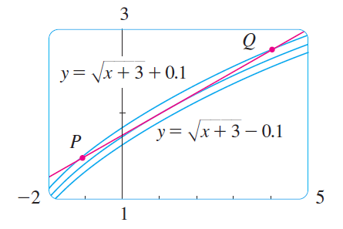

Slide 9
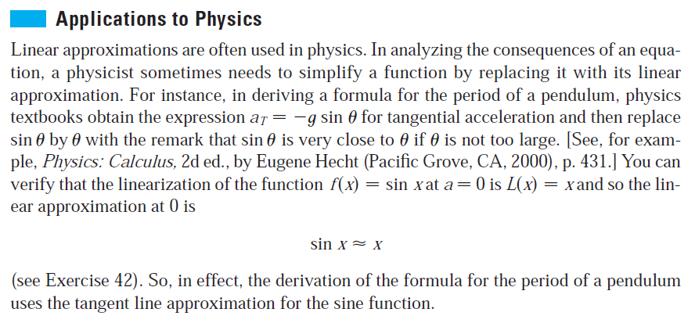

Slide 11
Differentials
The differential dy is an approximation of the small difference
Δy = f(x +Δx) – f(x)
Δx is a very small number, usually called the change in x.
The differential dx is meant to be the approximation of Δx.
But since we know exactly what Δx (because it is the input), so there is no need to approximate, and therefore by definition,
dx = Δx
And we will see that dy = f’(x) dx = $\frac{dy}{dx}∆x$

Slide 12
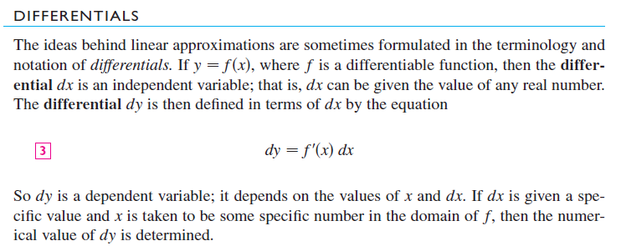
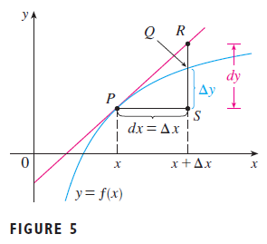
dy ≈ Δy

Slide 13
$$≈dy=f′(x)∆x$$

Slide 14
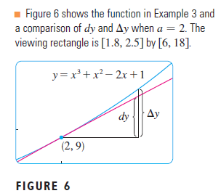
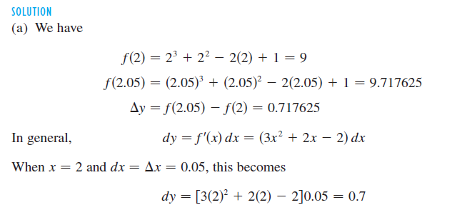

Slide 16
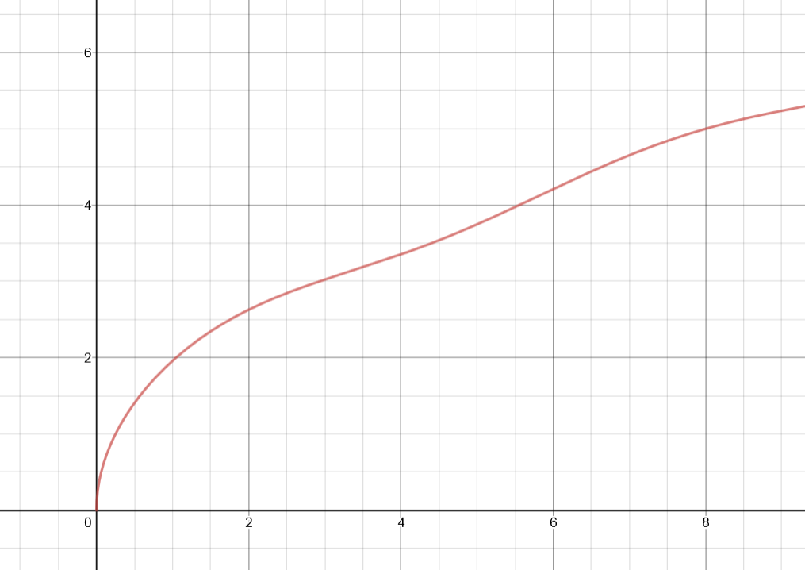
Additional example
Find the linear approximation $L(x)$ of the function $f\left(x\right)=\sqrt{3x+sinx}$ at the point $x=\frac{2π}{3}.$
Compare the exact value of $f\left(2.5\right)$ and the linear approximation $L\left(2.5\right).$

Slide 17
$$f^{′}\left(x\right)=\frac{3+\cos{x}}{2\sqrt{3x+\sin{x}}}, x_{1}=\frac{2π}{3}$$
$$f^{′}\left(\frac{2π}{3}\right)=\frac{3−1/2}{2\sqrt{2π+{\sqrt{3}}/2}}=\frac{2.5}{2×2.6738}=0.4675$$
$y_{1}=f\left(\frac{2π}{3}\right)=\sqrt{2π+{\sqrt{3}}/2}=2.6738$
Equation of tangent line: $y−y_{1}=m(x−x_{1})$
$$y−2.6738=0.4675(x−\frac{2π}{3})$$
Linear approximation $L\left(x\right)=0.4675\left(x−2.0944\right)+2.6738$
$$L\left(2.5\right)=0.4675\left(2.5−2.0944\right)+2.6738=2.8634$$
$$f\left(2.5\right)=\sqrt{3\left(2.5\right)+sin⁡(2.5)}=2.8458$$

Slide 18
